Slide 1
Smart Movies for a Smart Company
How Microsoft can make a splash in Hollywood

Slide 2


Business Understanding
Microsoft wishes to make movies and seeks guidance

Slide 3
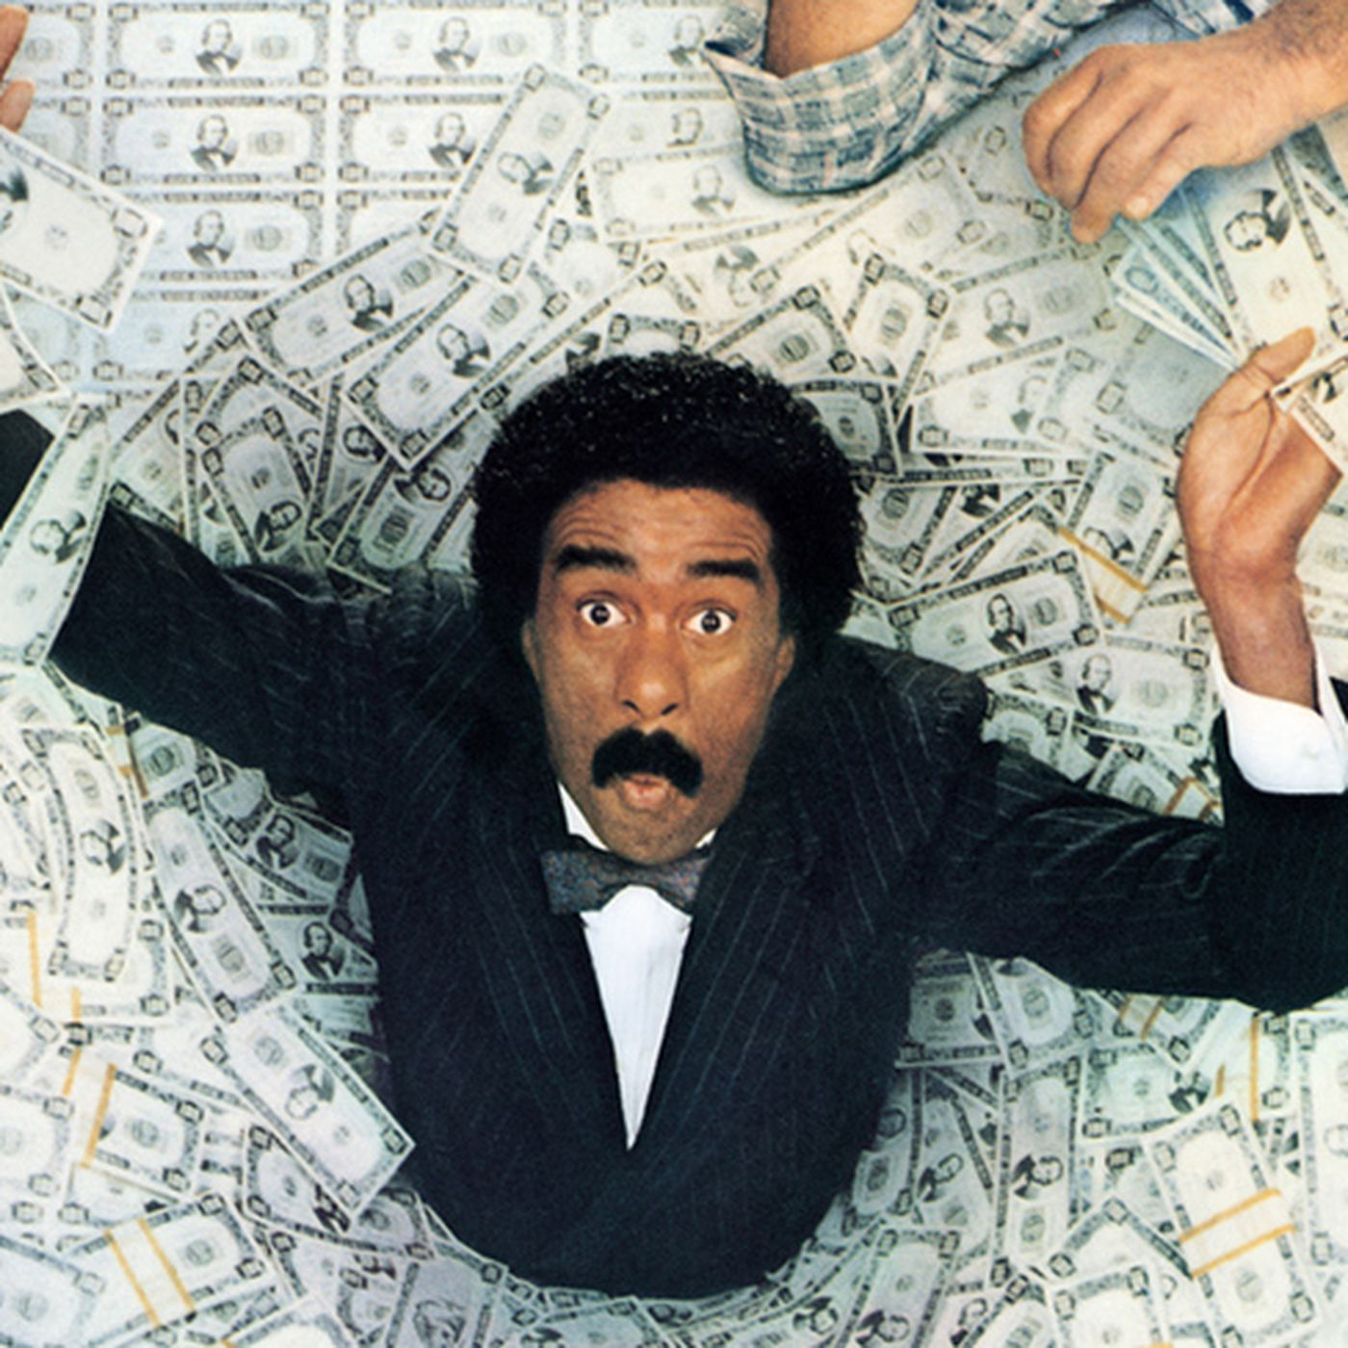
Business Understanding
What does it mean to be a “successful” movie? ROI

Slide 4

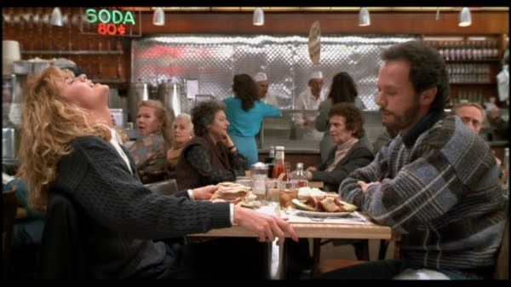

Business Understanding
What is success attributable to? Genre? Running time? Something else?

Slide 5





Data Understanding
Available data comes from a handful of sources

Slide 6
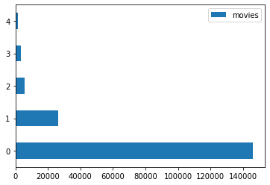
Data Understanding

Slide 7
26,517 movies
“popularity”
5,782 movies
grosses
budgets
3,387 movies
grosses (incomplete)
🚫
🚫
146,144 movies
runtimes
genres
cast and crew
1,560 movies
54,423 reviews
runtimes
ratings
no titles!!
✅
🚫
✅

Slide 8
146,144 movies
runtimes
genres
cast and crew

Slide 9
26,517 movies
“popularity”

Slide 10
5,782 movies
grosses
budgets

Slide 11
3,387 movies
grosses (incomplete)

Slide 12
1,560 movies
54,423 reviews
runtimes
ratings
no titles!!

Slide 13



146,144 movies
runtimes
genres
cast and crew
5,782 movies
grosses
budgets

Slide 14
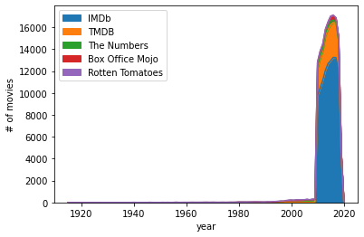
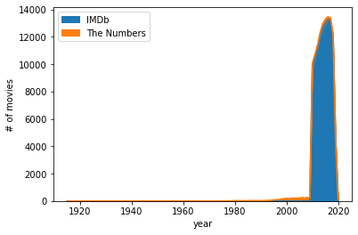
Data Understanding

Slide 15
Data Understanding
Solution:
2010-2018

Slide 16
Data Preparation
SOLVED:
remove duplicates
pull years from release dates
reformat strings as integers

Slide 17
Data Preparation
DISMISSED:
title mismatches (“Part II” vs. “Part Two”)
missing runtimes (5.4% of usable data)
missing genres (1.2% of usable data)

Slide 18
Data Preparation
FEATURE CREATION:
ROI
runtime intervals
distinct genres
“past profitability”
“budget experience”

Slide 19
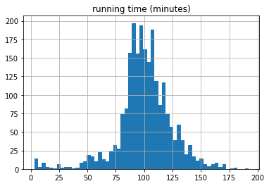
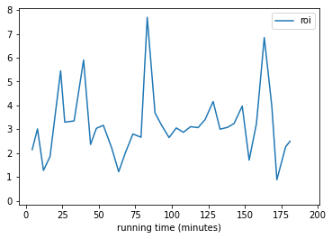
Modeling & Evaluation

Slide 20
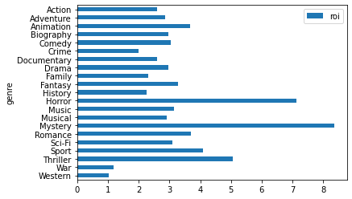
Modeling & Evaluation

Slide 21
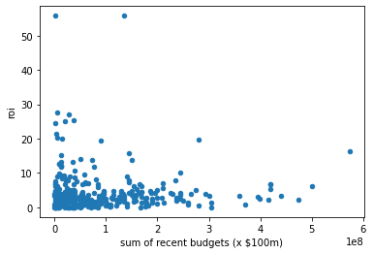
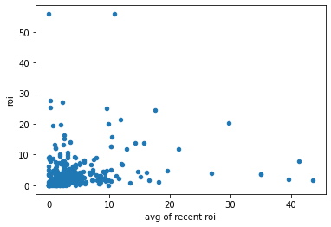
Modeling & Evaluation

Slide 22
Recommendations
Make a movie that’s 80-85 minutes long
Make it in the “horror” and/or “mystery” genre
Don’t worry about director experience

Slide 23
Thank you
Aaron Galbraith
www.linkedin.com/in/aarongalbraith

